Slide 1


Tom Brown
December 2, 2022

Slide 2

Outline
Executive Summary
Introduction
Methodology
Results
Conclusion

Slide 3
Executive Summary
Summary of methodologies
Data Collection
Data Wrangling
Exploratory Data Analysis with Data Visualization
Exploratory Data Analysis with SQL
Building an interactive map with Folium
Building a Dashboard with Plotly Dash
Predictive analysis (Classification)
Summary of all results
Exploratory Data Analysis results
Interactive analytics demo in screenshots
Predictive analysis results

Slide 4
Introduction
Background
SpaceX is a successful company of the commercial space age, making space travel affordable. The company advertises rocket launches on its website, with a cost of 62 million dollars; other providers cost upward of 165 million dollars each, much of the savings is because SpaceX can reuse the first stage. Therefore, if we can determine if the first stage will land, we can determine the cost of a launch. Based on public information and machine learning models, we are going to predict if SpaceX will reuse the first stage.
Problems you want to find answers
How do variables such as payload mass, launch site, number of flights, and orbits impact the success of the first stage landing?
Does the rate of successful landings increase over the years?
What is the best algorithm that can be used for binary classification in this case?

Slide 5

Section 1

Slide 6
Methodology
Executive Summary
Data collection methodology:
Utilizing SpaceX Rest API to gather Flight Number, Date, Booster Version, Payload Mass, Orbit, Launch Site, Outcome, Flights, Grid Fins, Reused, Legs, Landing Pad, Block, Reused Count, Serial, Longitude, Latitude
Perform data wrangling
Utilizing Web Scrapping from Wikipedia to gather Flight No., Launch site, Payload, Payload Mass, Orbit, Customer, Launch outcome, Version Booster, Booster landing, Date, Time
Perform exploratory data analysis (EDA) using visualization and SQL
Perform interactive visual analytics using Folium and Plotly Dash
Perform predictive analysis using classification models
Create array of data; standardize data; split data into training and testing data; perform GridSearch on four distinct classification models

Slide 7
Data Collection
The data collection process involved a combination of API requests from SpaceX rest API and web scraping data from a table in SpaceX’s Wikipedia entry.
Both rest API and Wikipedia web scraping collection methods were utilized to allow for a more comprehensive view of the data and allowed for more detailed analysis.

Slide 8
Data Collection – SpaceX API
Columns obtained by using SpaceX REST API: Flight Number, Date, Booster Version, Payload Mass, Orbit, Launch Site, Outcome, Flights, Grid Fins, Reused, Legs, Landing Pad, Block, Reused Count, Serial, Longitude, Latitude
GitHub Jupyter Notebook
Request rocket launch data from SpaceX API
Decode the response content using .json() and turn it into a dataframe using .json_normalize()
Request required data about the launches from SpaceX API by applying custom functions
Constructing dictionary from data obtained from API
Export the data to CSV
Replace missing values of Payload Mass column with calculated .mean()
Filtering the dataframe to only include Falcon 9 launches
Creating a dataframe from the dictionary

Slide 9
Data Collection - Scraping
Request Falcon 9 launch data from Wikipedia
Create a BeautifulSoup object from the HTML response
Extract all column names from the HTML table header
Collect the data by parsing HTML tables
Construct data we have obtained into a dictionary
Creating a dataframe from the dictionary
Exporting the data to CSV
Columns obtained by using Wikipedia Web Scraping: Flight No., Launch site, Payload, Payload Mass, Orbit, Customer, Launch outcome, Version Booster, Booster landing, Date, Time
GitHub Jupyter Notebook

Slide 10
Data Wrangling
There were several different cases where the booster did not land successfully. True RTLS means the mission outcome was successfully landed to a ground pad False RTLS means the mission outcome was unsuccessfully for the ground pad. True ASDS means the mission outcome was successfully landed on a drone ship False ASDS means the mission outcome was unsuccessfully landed on a drone ship. These conditions were coded to Training labels with “1” meaning successful landing, “0” meaning it was unsuccessful. This allows the values to be analyzed by the model.
GitHub jupyter Notebook
Perform exploratory Data Analysis and determine Training Labels
Calculate the number of launches on each site
Calculate the number and occurrence of each orbit
Calculate the number and occurrence of mission outcome per orbit type
Create a landing outcome label from Outcome column
Exporting the datato CSV

Slide 11
EDA with Data Visualization
Generated Charts
Flight Number vs. Payload Mass | Flight Number vs. Launch Site
Payload Mass vs. Launch Site | Orbit Type vs. Success Rate
Flight Number vs. Orbit Type | Payload Mass vs Orbit Type
Success Rate Yearly Trend | Various scatter plots showing relationship between variables.
Bar chart showing comparison between categories | Line chart showing trends over time.
GitHub Jupyter Notebook

Slide 12
EDA with SQL
Generated SQL Queries to produce the following information:
Displaying the names of the unique launch sites in the space mission
Displaying 5 records where launch sites begin with the string ‘CCA'
Displaying the total payload mass carried by boosters launched by NASA (CRS)
Displaying average payload mass carried by booster version F9 v1.1
Listing the date when the first successful landing outcome in ground pad was achieved
Listing the names of the boosters which have success in drone ship and have payload mass greater than 4000 but less than 6000
Listing the total number of successful and failure mission outcomes
Listing the names of the booster versions which have carried the maximum payload mass
Listing the failed landing outcomes in drone ship, their booster versions and launch site names for the months in year 2015
Ranking the count of landing outcomes between the date 2010-06-04 and 2017-03-20 in descending order
GitHub Jupyter Notebook

Slide 13
Build an Interactive Map with Folium
Generated Interactive Folium Maps for the following data:
Markers of all Launch Sites
Marker with Circle, Popup Label and Text Label of NASA Johnson Space Center using its latitude and longitude coordinates as a start location.
Markers with Circle, Popup Label and Text Label of all Launch Sites using their latitude and longitude coordinates to show their geographical locations and proximity to Equator and coasts.
Colored Markers of the launch outcomes for each Launch Site
colored Markers of success (Green) and failed (Red) launches using Marker Cluster to identify which launch sites have relatively high success rates.
Distances between a Launch Site to significant Landmarks
Include colored lines to show distances between the Launch Site CCAFS-SLC-40 and significant landmarks like Railway, Highway, Coastline and Closest City.
GitHub Jupyter Notebook

Slide 14
Build a Dashboard with Plotly Dash
Launch Sites Dropdown List
Added a pie chart to show the total successful launches count for all sites or the selected launch site
Success vs. Failed counts for the site, if a specific Launch Site was selected.
Added a slider to select Payload range.
Added a scatter chart to show the correlation between Payload and Launch Success.
Github Plotly Dashboard

Slide 15
Predictive Analysis (Classification)
Create a NumPy array from the column “Class” in data
Standardize the data with StandardScaler, then fitting and transforming it
Split the data into training and testing sets with train_test_split function
Creating a GridSearchCV object with cv = 10 to find the best parameters
Calculate the accuracy on the test data using the method .score() for all models
Github Jupyter Notebook

Slide 16
Results
Exploratory data analysis results
Interactive analytics demo in screenshots
Predictive analysis results

Slide 17

Section 2

Slide 18
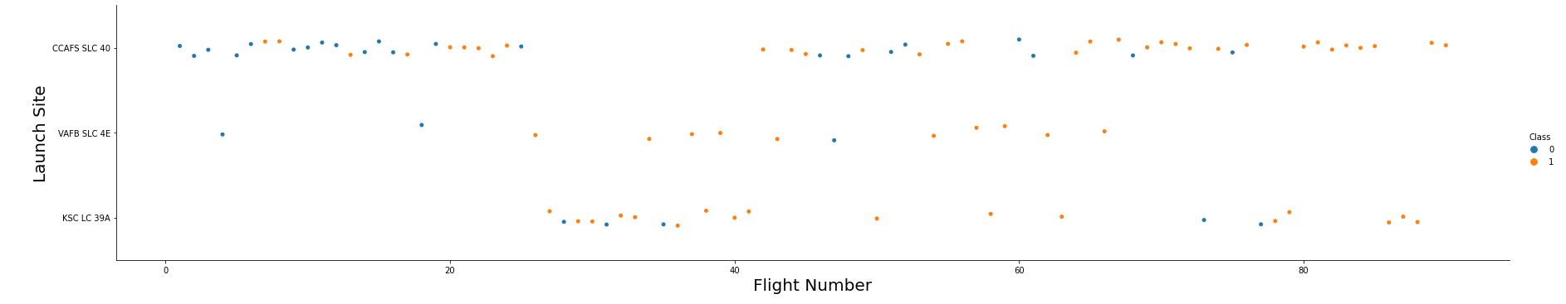
Flight Number vs. Launch Site
The earliest flights all failed while the latest flights all succeeded.
The CCAFS SLC 40 launch site has about a half of all launches.
VAFB SLC 4E and KSC LC 39A have higher success rates.
Higher success rates appear to increase with each flight.

Slide 19
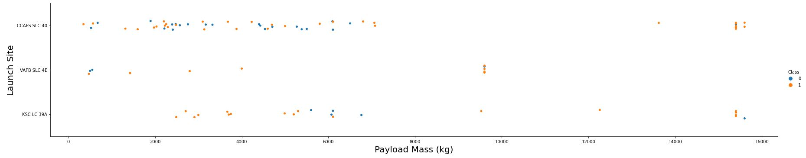
Payload vs. Launch Site
For every launch site the higher the payload mass, the higher the success rate.
Most of the launches with payload mass over 7000 kg were successful.
KSC LC 39A has a 100% success rate for payload mass under 5500 kg.

Slide 20
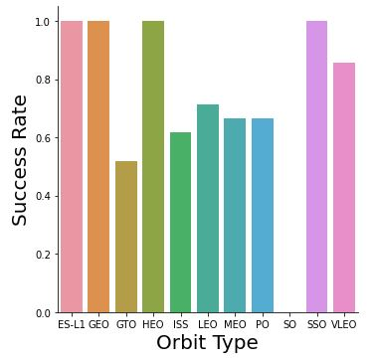
Success Rate vs. Orbit Type
Orbits ES-L1, GEO, HEO, SSO have a 100% success rate
Orbit SO has a 0% success rate
All other orbits have a success rate between 50% and 85%.

Slide 21
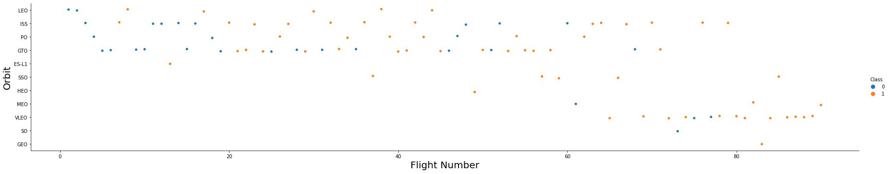
Flight Number vs. Orbit Type
In the LEO orbit, the Success appears related to the number of flights.
There seems to be no relationship between flight number when in GTO orbit.

Slide 22
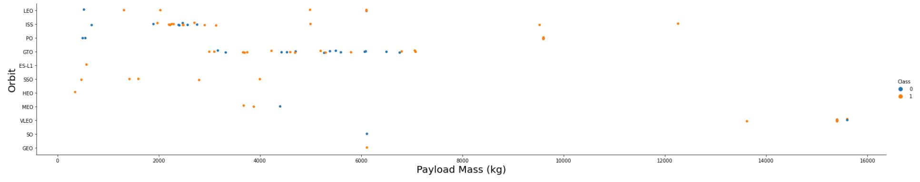
Payload Mass vs. Orbit Type
Heavy payloads have a negative influence on GTO orbits and positive on GTO and Polar LEO (ISS) orbits.

Slide 23
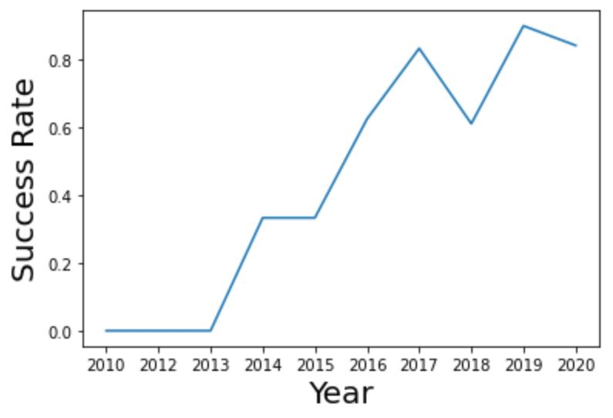
Launch Success Yearly Trend
With the exception of 2018 and 2020, the success rate has steadily increased since the program began.

Slide 24
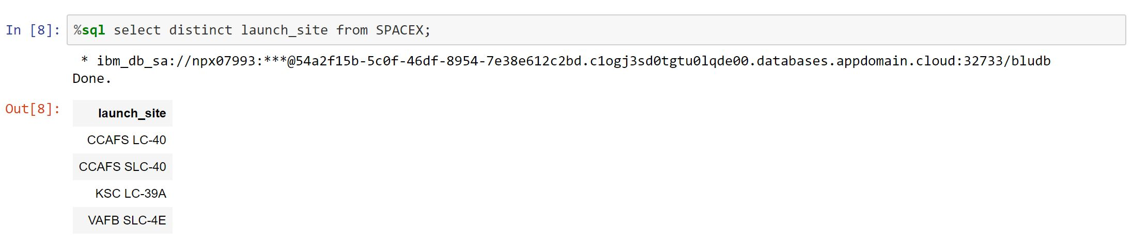
All Launch Site Names
Displaying the names of the unique launch sites in the space mission.

Slide 25
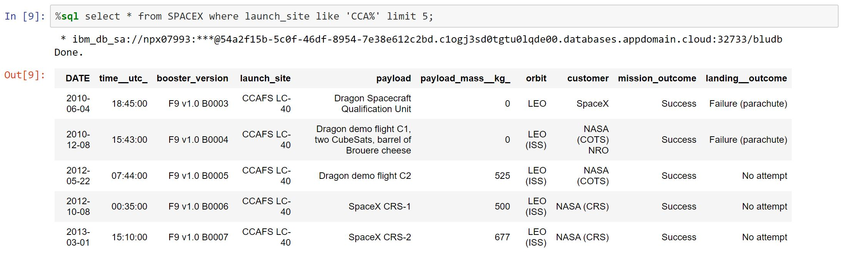
Launch Site Names Begin with 'CCA'
Displaying 5 records where launch sites begin with the string 'CCA'.

Slide 26
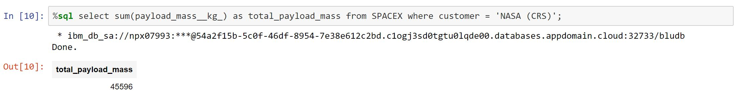
Total Payload Mass
Displaying the total payload mass carried by boosters launched by NASA (CRS).

Slide 27
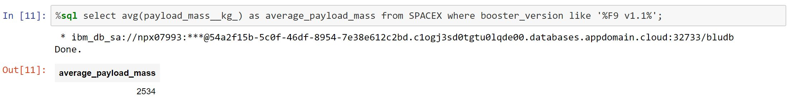
Average Payload Mass by F9 v1.1
Displaying average payload mass carried by booster version F9 v1.1.

Slide 28
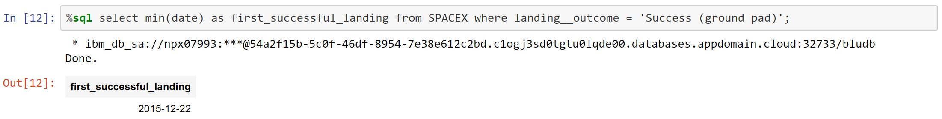
First Successful Ground Landing Date
Listing the date when the first successful landing outcome in ground pad was achieved.

Slide 29
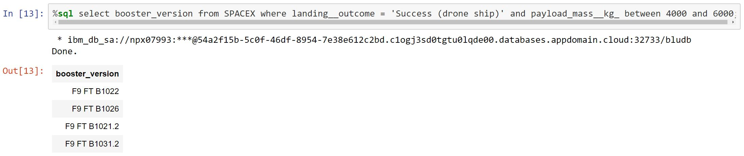
Successful Drone Ship Landing with Payload between 4000 and 6000
Listing the names of the boosters which have success in drone ship and have payload mass greater than 4000 but less than 6000.

Slide 30
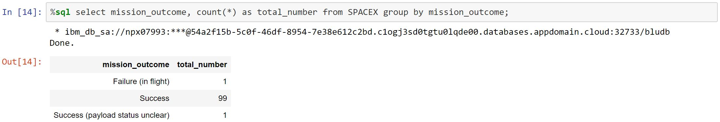
Total Number of Successful and Failure Mission Outcomes
Listing the total number of successful and failure mission outcomes.

Slide 31
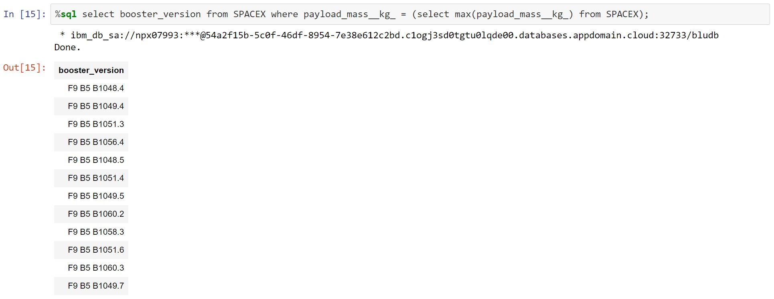
Boosters Carried Maximum Payload
Listing the names of the booster versions which have carried the maximum payload mass.

Slide 32
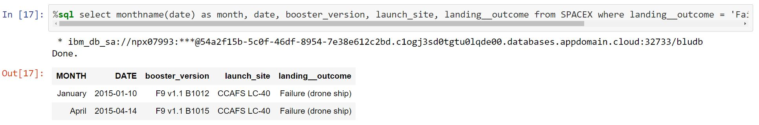
2015 Launch Records
Listing the failed landing outcomes in drone ship, their booster versions and launch site names for the months in year 2015.

Slide 33
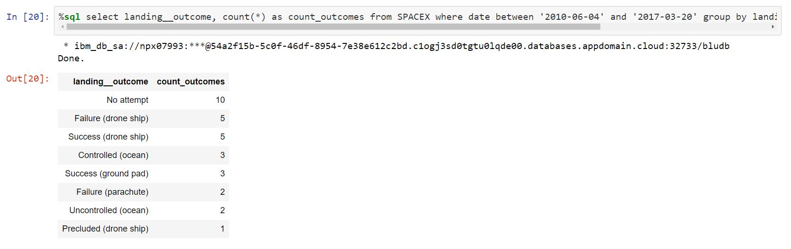
Rank Landing Outcomes Between 2010-06-04 and 2017-03-20
Rank the count of landing outcomes (such as Failure (drone ship) or Success (ground pad)) between the date 2010-06-04 and 2017-03-20, in descending order

Slide 34

Section 3

Slide 35
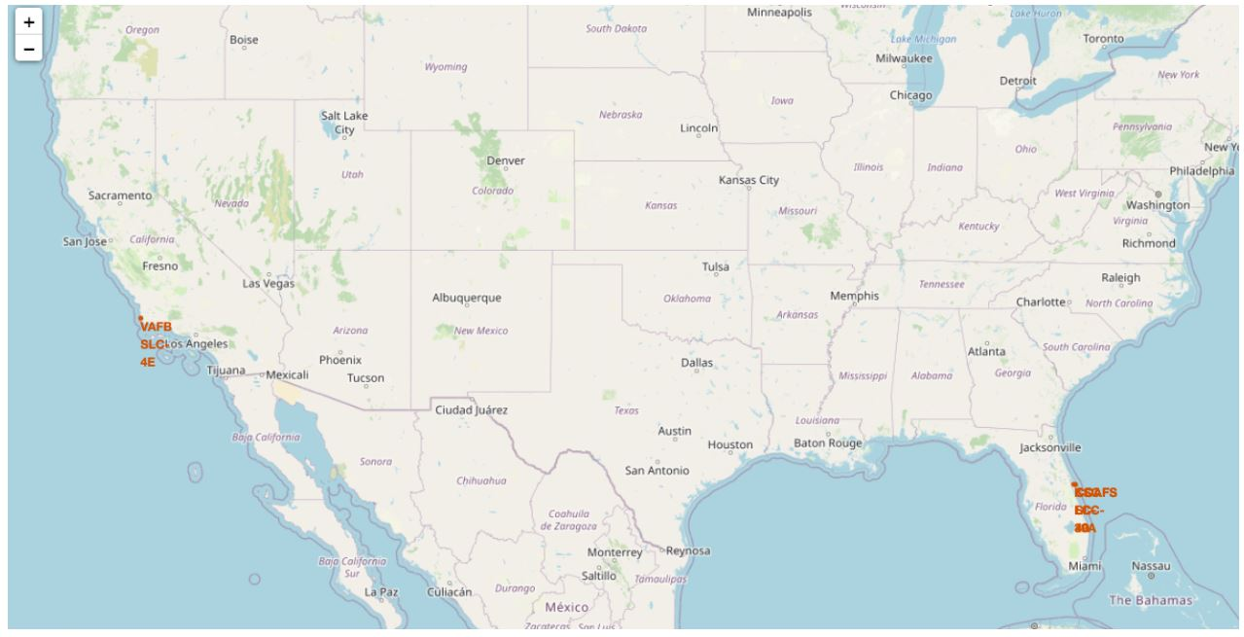
SpaceX Launch Sites
Launch sites are in proximity to the Equator line.
The land is moving faster at the equator than any other place on the surface of the Earth.
Ships launched from the equator it go up into space, stay in space because of inertia and they are traveling at the same speed as they were launched.
Launch sites are in close proximity to the coast to minimize the risk of having any debris dropping or exploding near people.

Slide 36
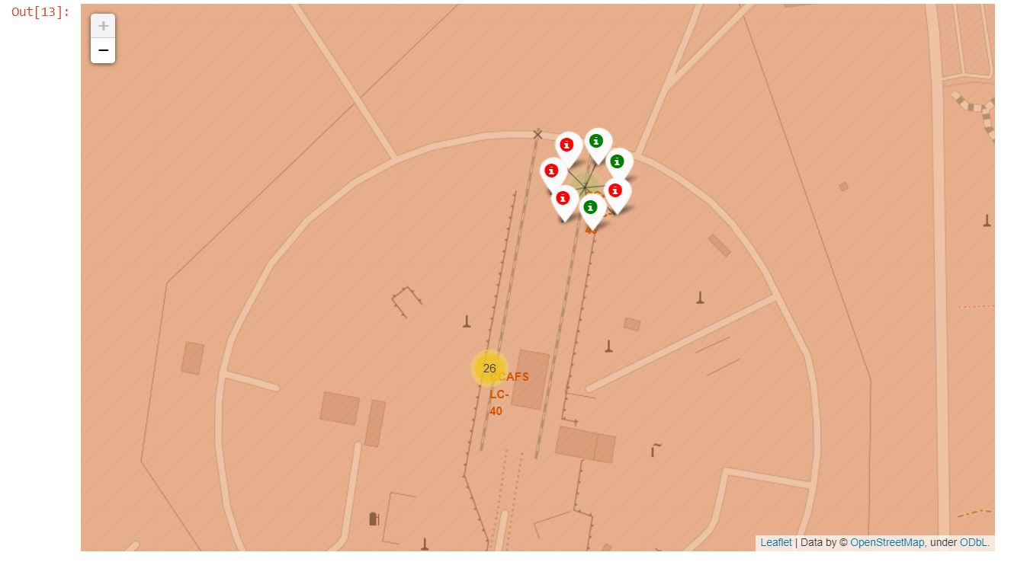
Marked Color Launch Locations by Coordinates
Successful and failed launches are easily identified because of the colored markers.
Green Marker = Successful Launch
Red Marker = Failed Launch

Slide 37
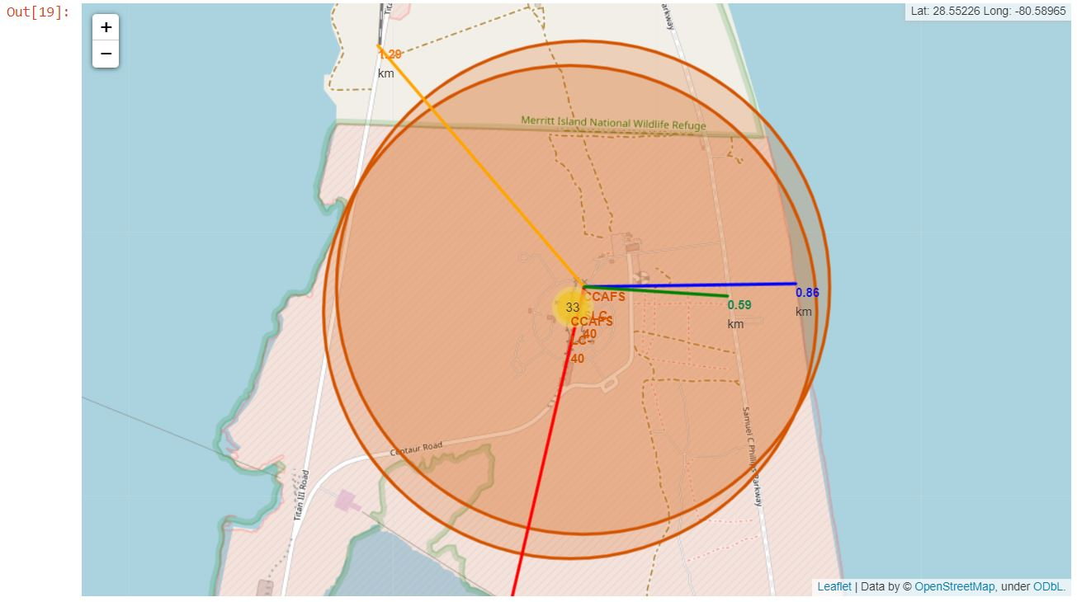
Launch Location Relative to Landmarks
From the visual analysis of the launch site CCAFS-SLC-40 we can clearly see that it is:
Proximity to City (17.96 km)
Proximity to Coastline (0.86 km)
Proximity to Highway (0.59 km)
Proximity to Railway (1.29 km)
Failed rocket with its high speed can cover distances like 15-20 km in few seconds. It could be potentially dangerous to populated areas.

Slide 38

Section 4

Slide 39
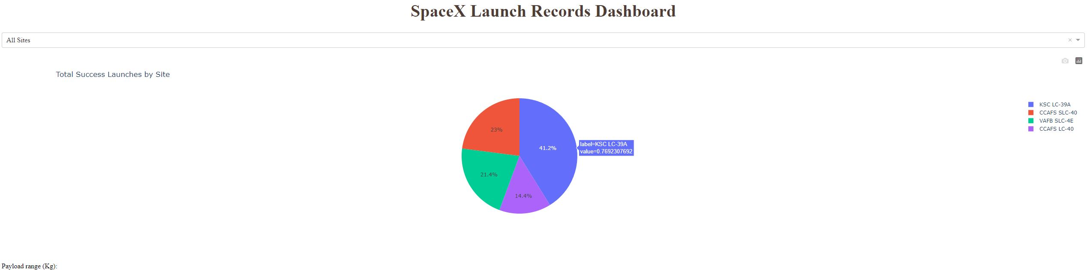
Launch Percentages for All Launch Sites
The chart shows that from all the sites, KSC LC-39A has the most successful launches.

Slide 40
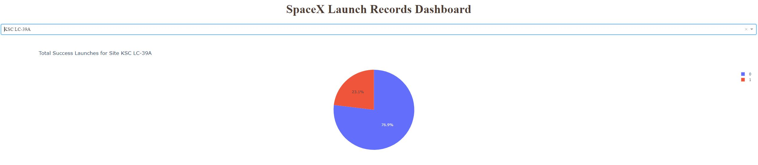
Launch Percentage for Most Successful Site
KSC LC-39A has the highest launch success rate (76.9%) with 10 successful and only 3 failed landings.

Slide 41
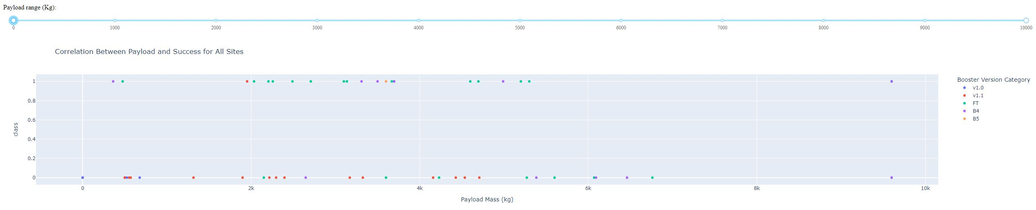
Payload Mass vs. Launch Outcome All Sites
The charts show that payloads between 2000 and 5500 kg have the highest success rate.

Slide 42

Section 5

Slide 43
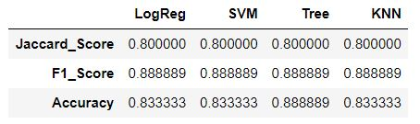
Classification Accuracy
Based on the scores of the Test Set, we can not confirm which method performs best.
Same Test Set scores may be due to the small test sample size (18 samples).

Slide 44
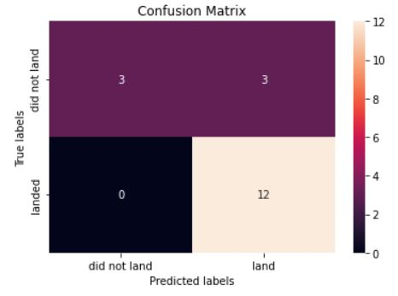
Confusion Matrix
Examining the confusion matrix, the logistic regression can distinguish between the different classes. The largest problem is false positives.

Slide 45
Conclusions
KSC LC-39A has the highest success rate of the launches from all the sites.
Orbits ES-L1, GEO, HEO and SSO have 100% success rate.
Launches with a low payload mass show better results than launches with a larger payload mass.
Most of launch sites are in proximity to the Equator line and all the sites are in very close proximity to the coast.
The success rate of launches increases over the years.

Slide 46


